Slide 1
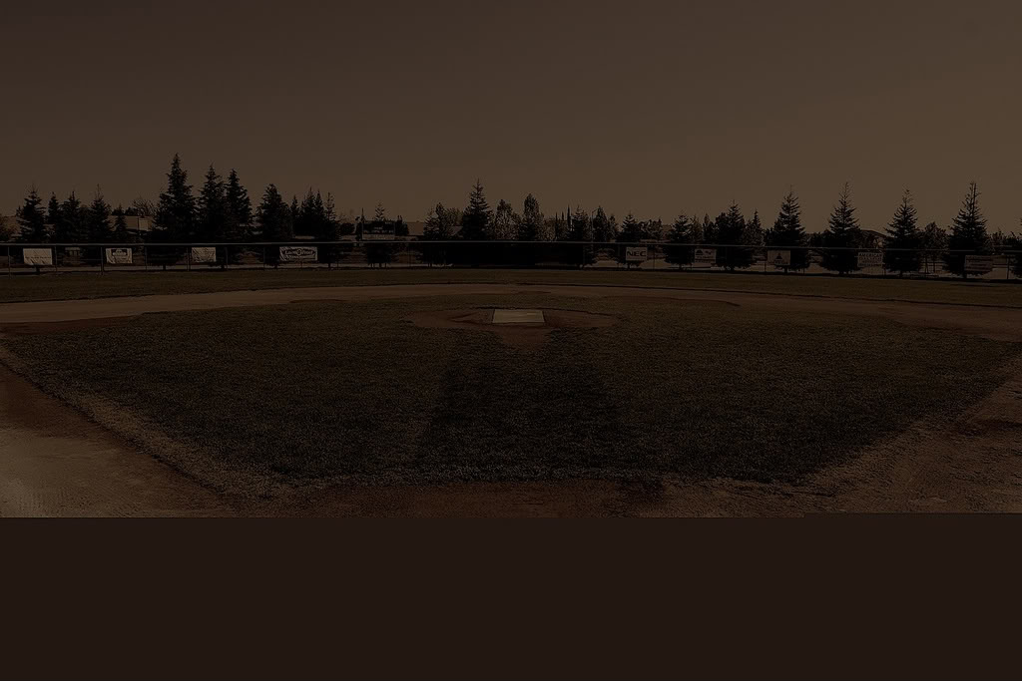
Dark Ball Field

Slide 2
Wet Wooden Bench

Slide 3
Cold Brick

Slide 4
Dew Grass

Slide 5
Sky Blue Bottle

Slide 6
Sweet Raspberry Taste

Slide 7
Angry Music

Slide 8
Lighter Flames

Slide 9
Solitude

Slide 10
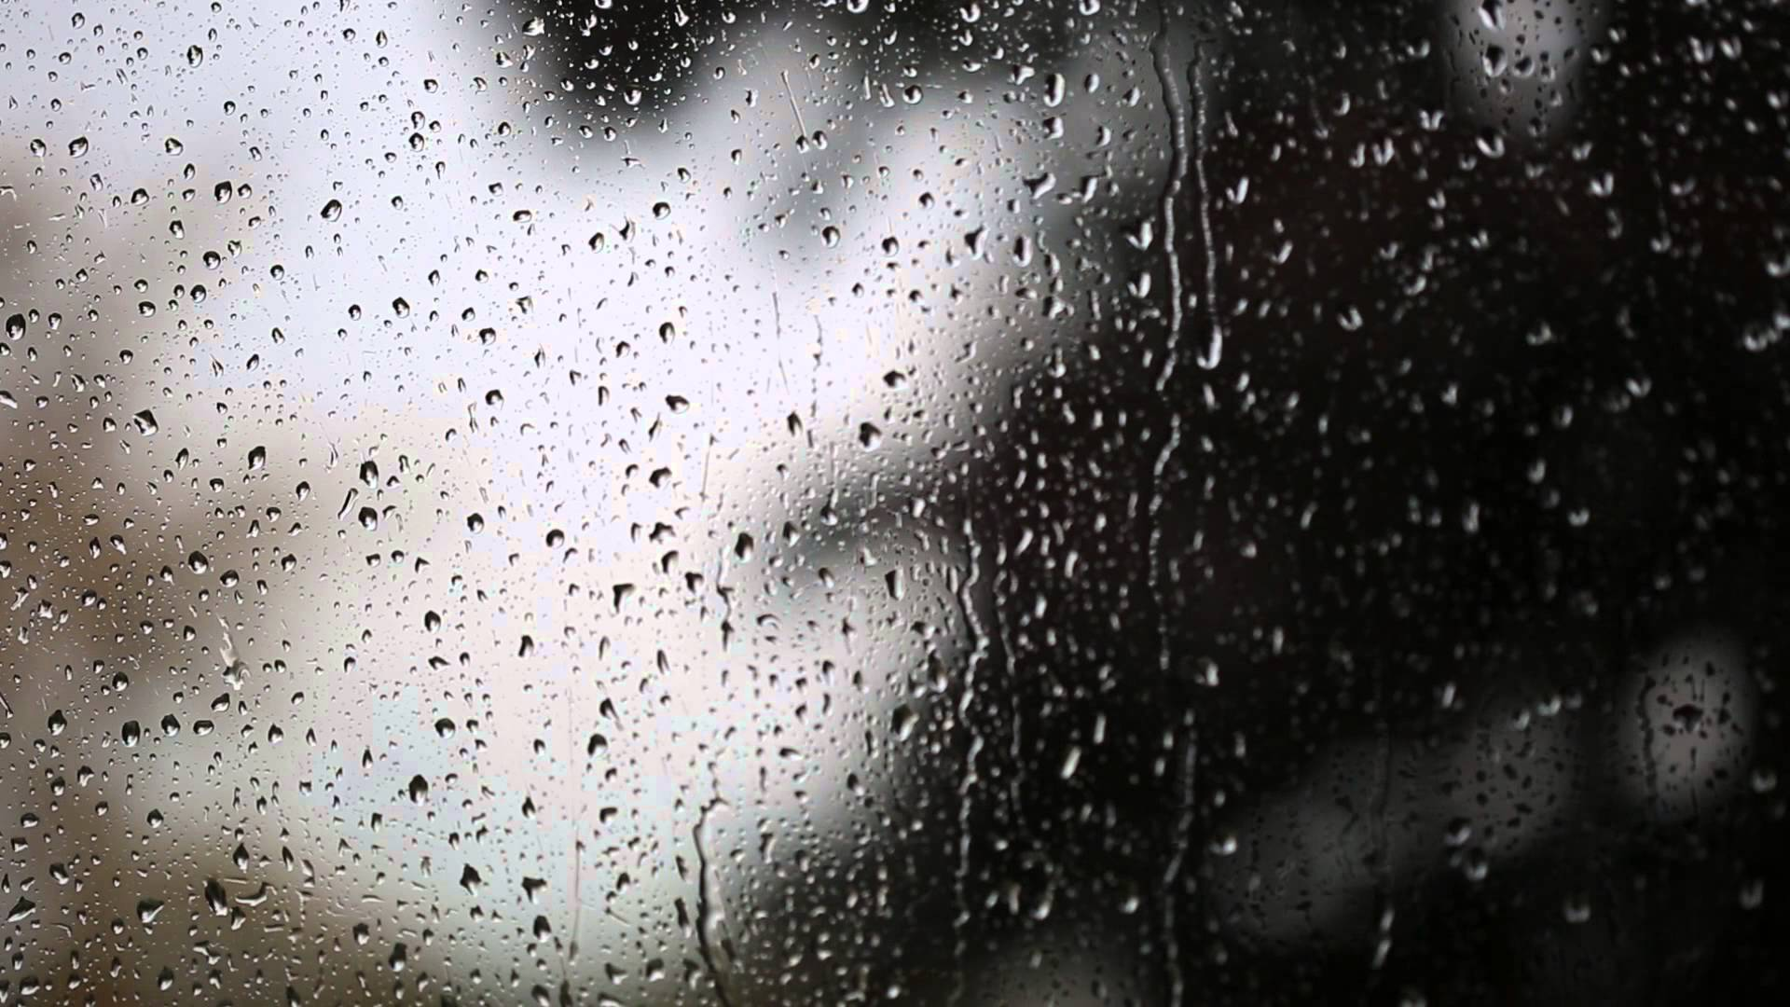
Rain on windows

Slide 11
Candles

Slide 12
Low temperature

Slide 13
Dark Mood

Slide 14
Sobs

Slide 15
locked doors

Slide 16
Pants of helplessness

Slide 17
forgiveness

Slide 18
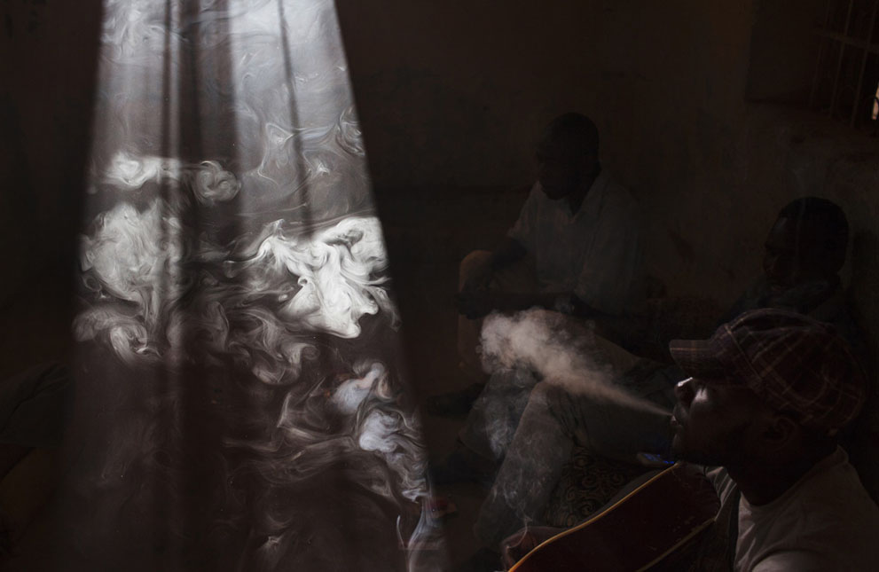
Sketchy apartment

Slide 19
Black Outfit

Slide 20
Wooden Cut-Up Table

Slide 21
Blue La-Z-Boy

Slide 22
Plastic Water Jug

Slide 23
Smokey Room

Slide 24
Dizziness

Slide 25
Paralyzed Body

Slide 26
No Sight

Slide 27
No Hope

Slide 28
Family Knot

Slide 29
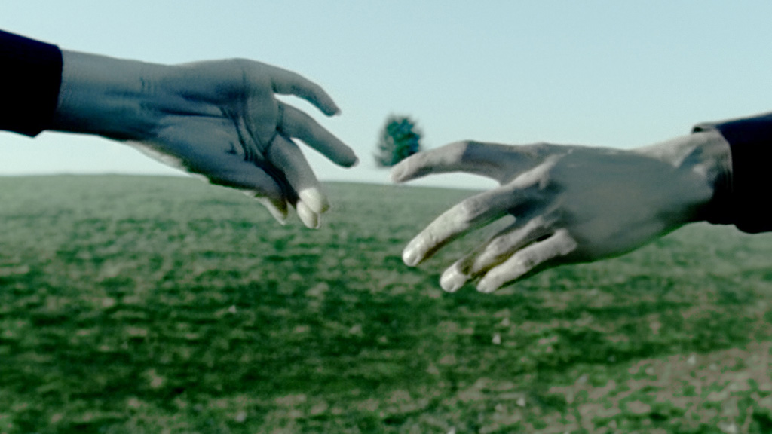
Suitcases

Slide 30
BIlls

Slide 31
Unanswered phone calls

Slide 32
Drags of cigs

Slide 33
drinking

Slide 34
invoices

Slide 35
Calls from er

Slide 36
uneasiness

Slide 37
Brokenness

Slide 38
disappointment

Slide 39
Never forget

