Slide 1
Drowning

Slide 2
Gasping

Slide 3
Rocking

Slide 4
Sweating

Slide 5
Pacing

Slide 6
Shaking

Slide 7
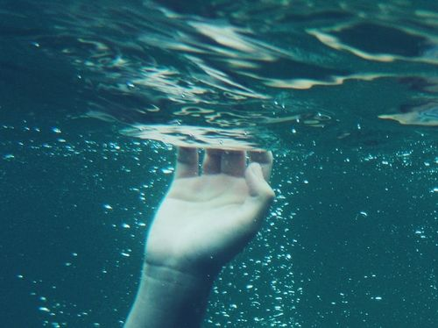
I am

Slide 8
trying

Slide 9
my best

Slide 10
to stay

Slide 11
afloat,

Slide 12
but

Slide 13
the harder

Slide 14
I kick

Slide 15
the farther

Slide 16
the surface

Slide 17
seems to be.

Slide 18
But that’s

Slide 19
the thing

Slide 20
with anxiety,

Slide 21
the more

Slide 22
you struggle

Slide 23
the worse

Slide 24
it gets

Slide 25
resulting in

Slide 26
silence

